Slide 1
Quantum Monte-Carlo
A neural network approach to wave
function optimizations

Slide 2
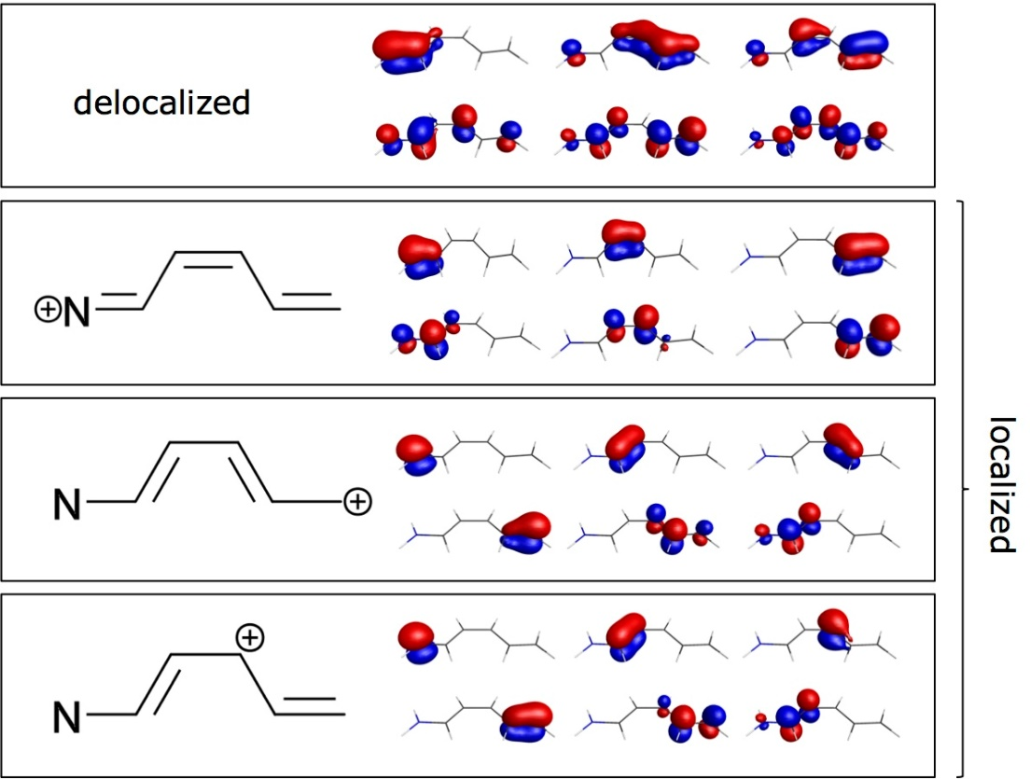
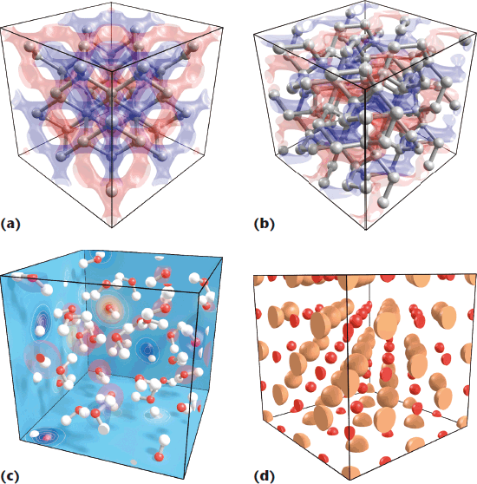
Quantum Monte Carlo ?
Accurate electronic structure calculations
at a ‘moderate’ cost

Slide 3
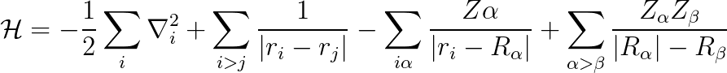
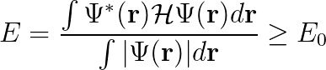
Quantum Monte Carlo ?
Schrodinger
Equation
Variational
Energy

Slide 4
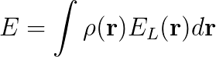
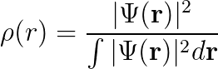
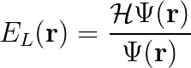
Quantum Monte Carlo ?
Schrodinger
Equation
Variational
Energy
Density
Local Energy

Slide 5
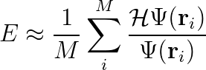
Quantum Monte Carlo ?
Schrodinger
Equation
Variational
Energy
Density
Local Energy

Slide 6
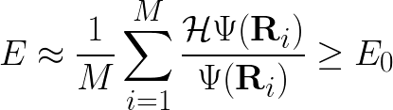
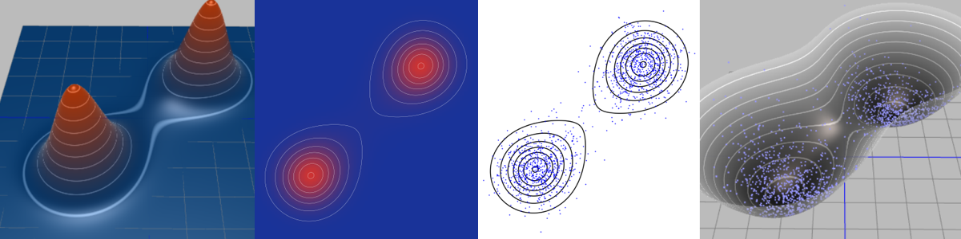
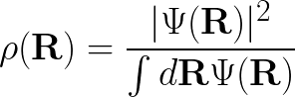
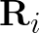

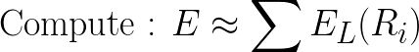
Quantum Monte Carlo ?
MC Sampling

Slide 7
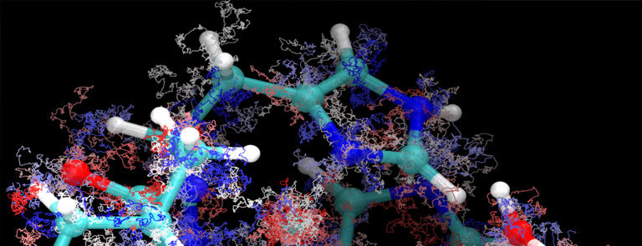
Quantum Monte Carlo ?

Slide 8
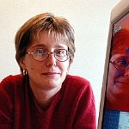
Quantum Monte Carlo ?
Claudia Filippi
Twente
Accelerating Quantum Monte Carlo
using GPUs & Machine Learning*
*base code in Fortran 77

Slide 9
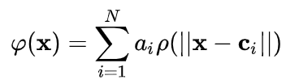
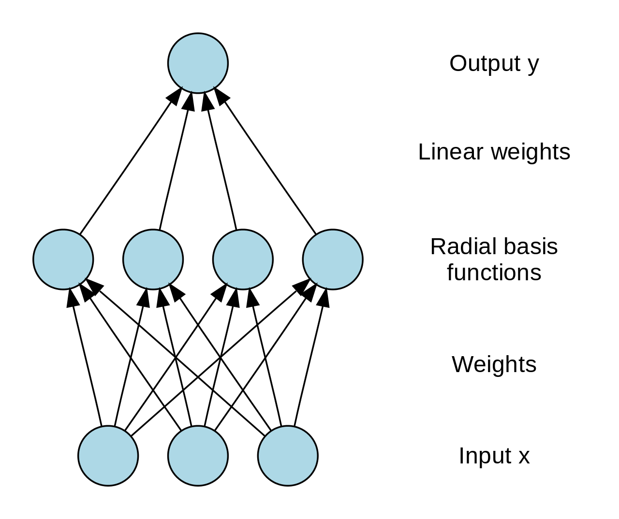
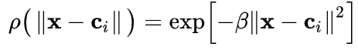
Radial Basis Function Neural Network
… a radial basis function network is an artificial neural network that uses radial basis functions as activation functions. … [they] have many uses, including function approximation, time series prediction, classification, …
https://en.wikipedia.org/wiki/Radial_basis_function_network

Slide 10
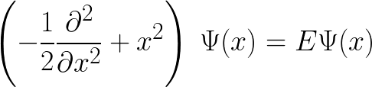
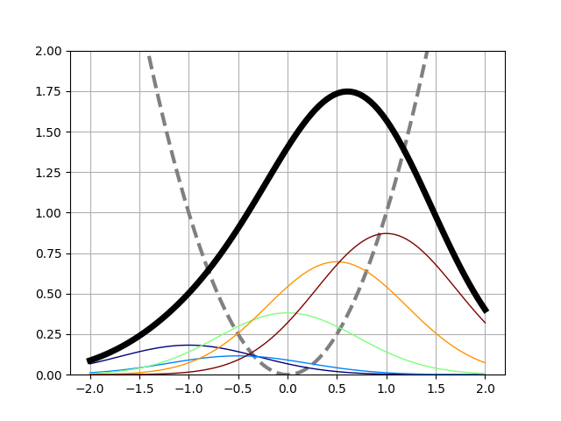
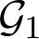
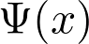
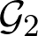
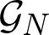
A RBF-NN approach to WF optimization : Toy Models
Harmonic Oscillator
In one dimension
https://github.com/NLESC-JCER/DeepQMC

Slide 11
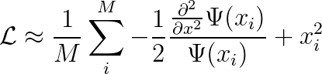
A RBF-NN approach to WF optimization : Toy Models
Harmonic Oscillator
In one dimension
Use local energy as loss function
Batched
Sampling
Points
https://github.com/NLESC-JCER/DeepQMC

Slide 12
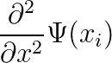
A RBF-NN approach to WF optimization : Toy Models
Harmonic Oscillator
In one dimension
Use local energy as loss function
Batched
Sampling
Points
Kinetic energy
via automatic
differentiation
https://github.com/NLESC-JCER/DeepQMC

Slide 13
A RBF-NN approach to WF optimization : Toy Models
Harmonic Oscillator
In one dimension
1 - Initialize the network
2 - Sample the density of the initial wave function
3 - Loop over epoch
a - compute the wave function
b- compute the loss
c - compute the gradients
d - optimize the parameters
e - re-sample the new wave function
Batched
Sampling
Points
https://github.com/NLESC-JCER/DeepQMC

Slide 14

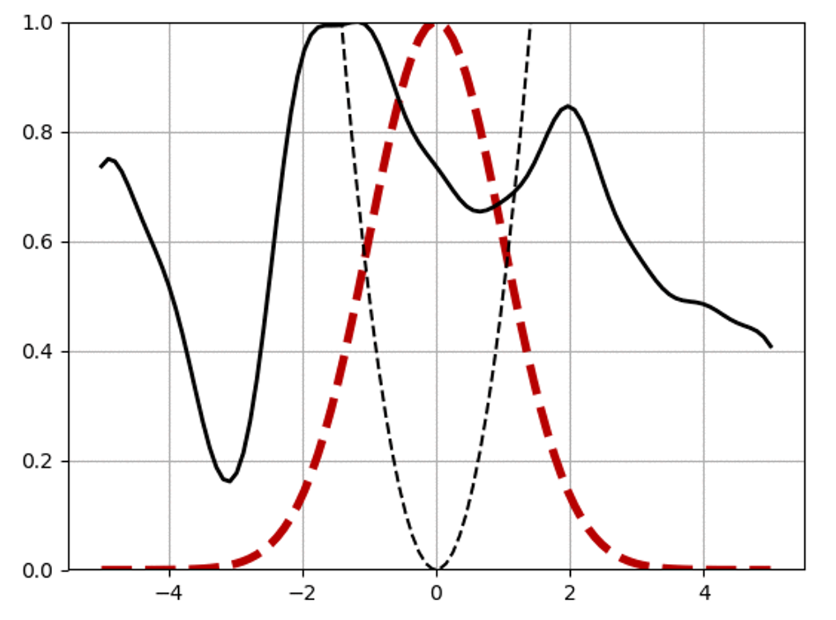
A RBF-NN approach to WF optimization : Toy Models
https://github.com/NLESC-JCER/DeepQMC

Slide 15
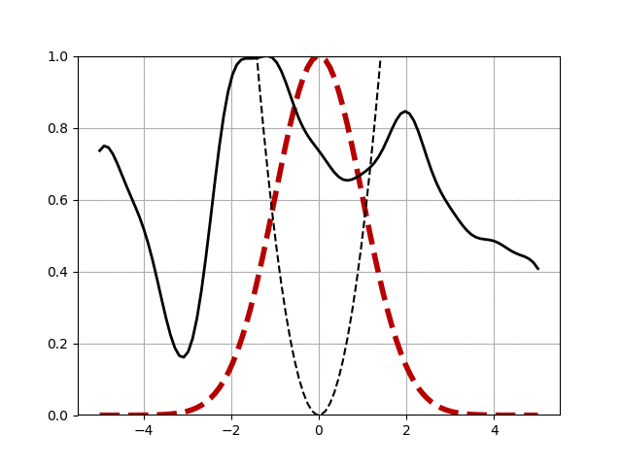
A RBF-NN approach to WF optimization : Toy Models
https://github.com/NLESC-JCER/DeepQMC

Slide 16
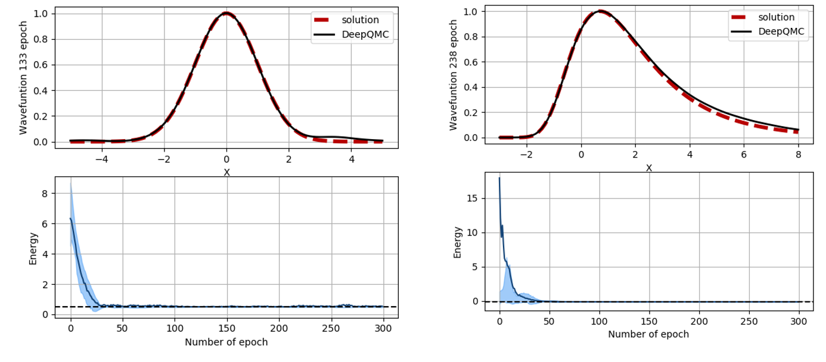
A RBF-NN approach to WF optimization : Toy Models
11 RBFs
Harmonic Oscillator
In one dimension
Morse Potential
in one dimension
https://github.com/NLESC-JCER/DeepQMC

Slide 17

A RBF-NN approach to WF optimization : Toy Models
11 RBFs
DeepQMC
The Game !
Harmonic Oscillator
In one dimension
Morse Potential
in one dimension
https://github.com/NLESC-JCER/DeepQMC

Slide 18
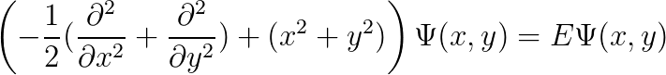
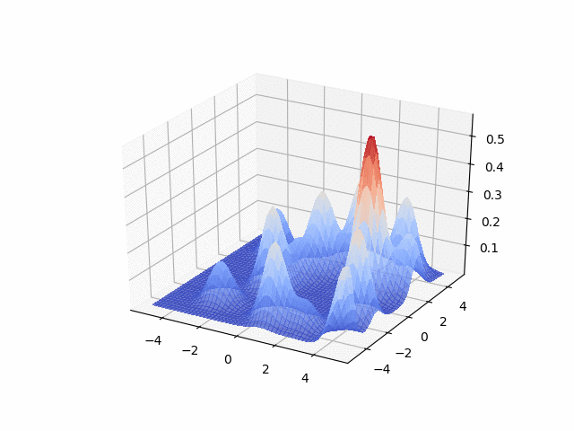
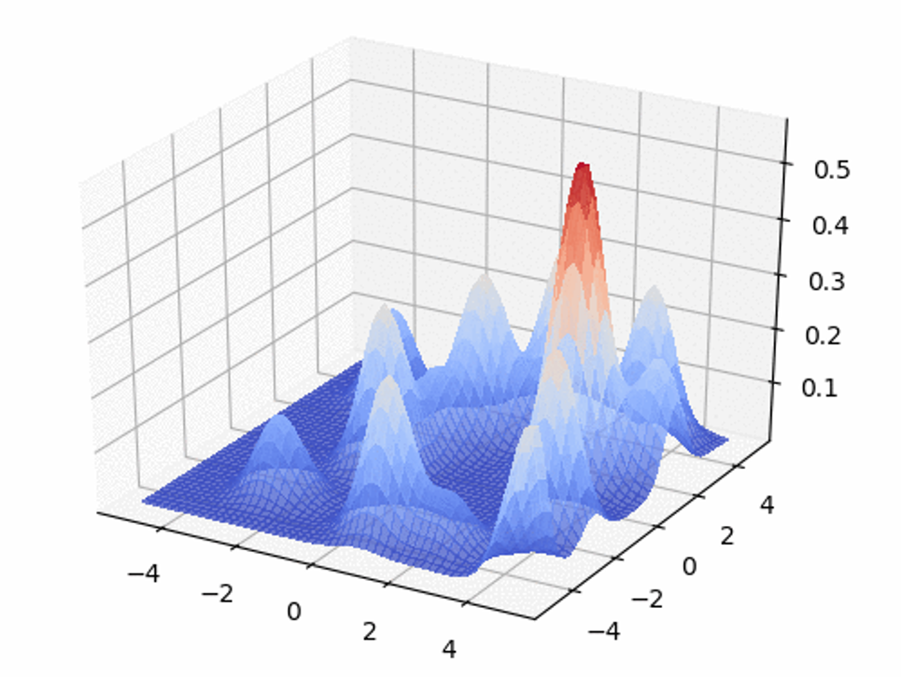
Now in 2D !

Slide 19
Now in 2D !

Slide 20
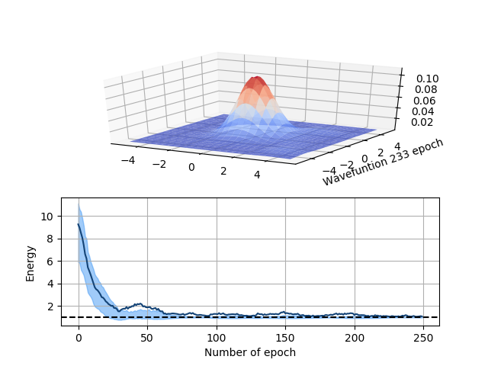
Now in 2D !

Slide 21
RBF for QMC
What about
Real Systems ?

Slide 22
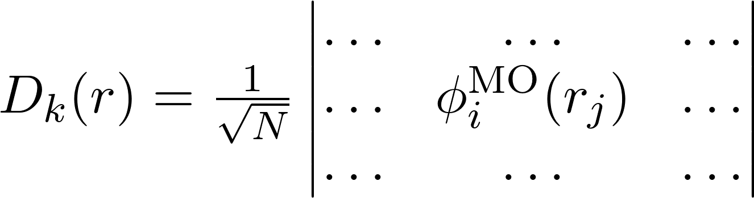
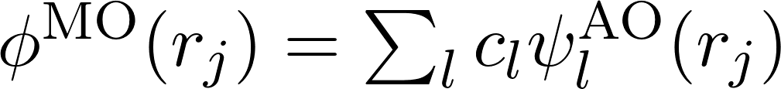
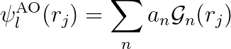
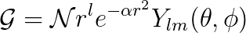
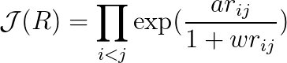
DeepQMC for molecular systems
Wave Function
Slater Determinant
Molecular Orbital
Atomic Orbital
Basis function
Jastrow factors

Slide 23
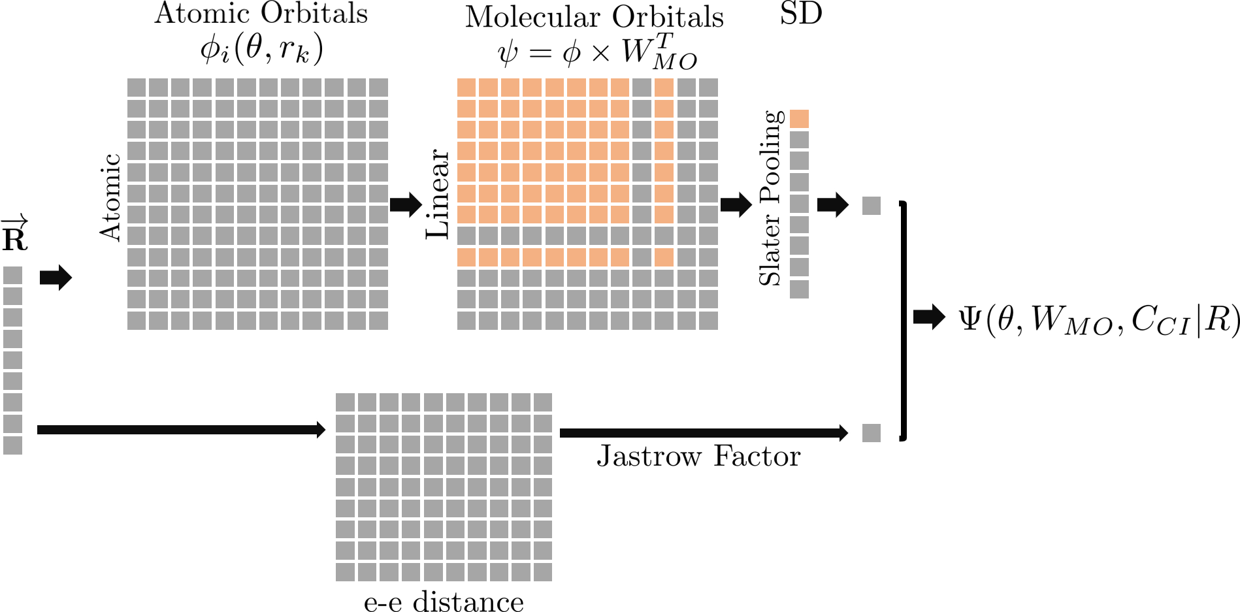
Quantum Chemistry in pyTorch

Slide 24
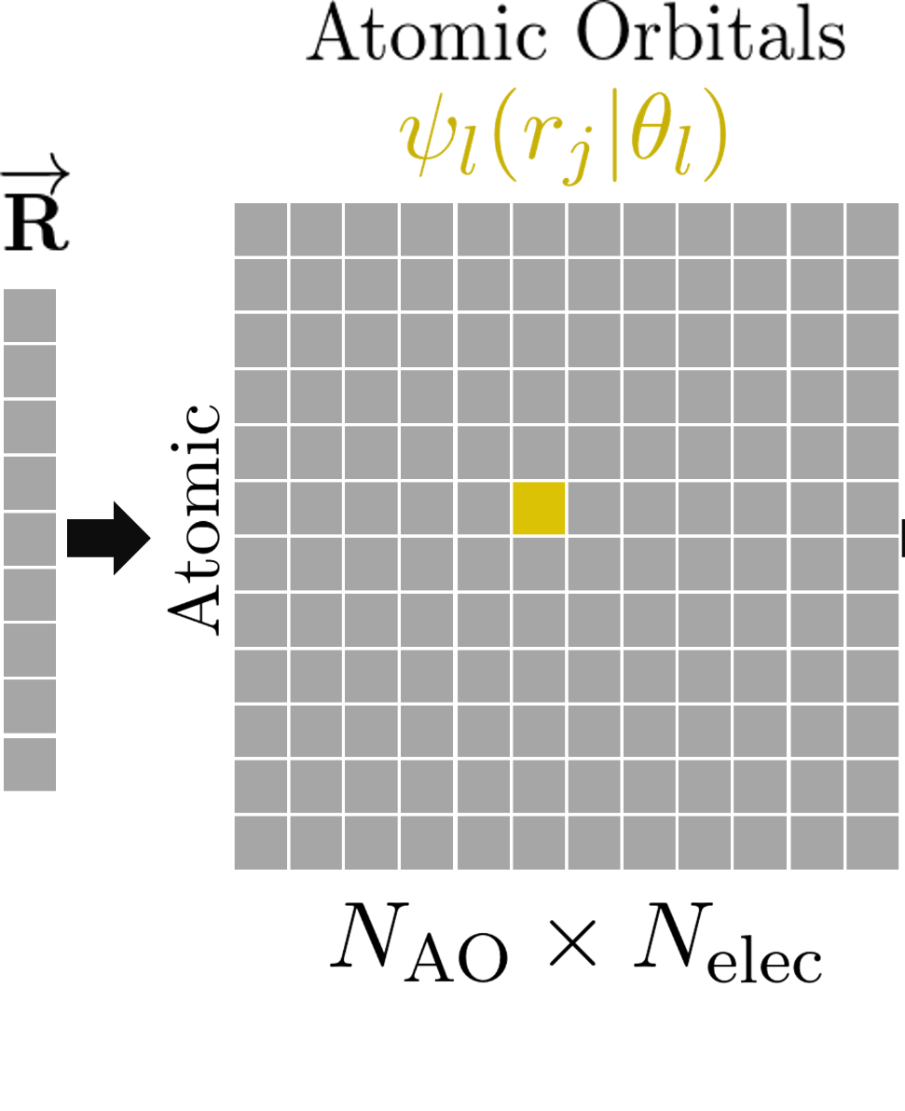
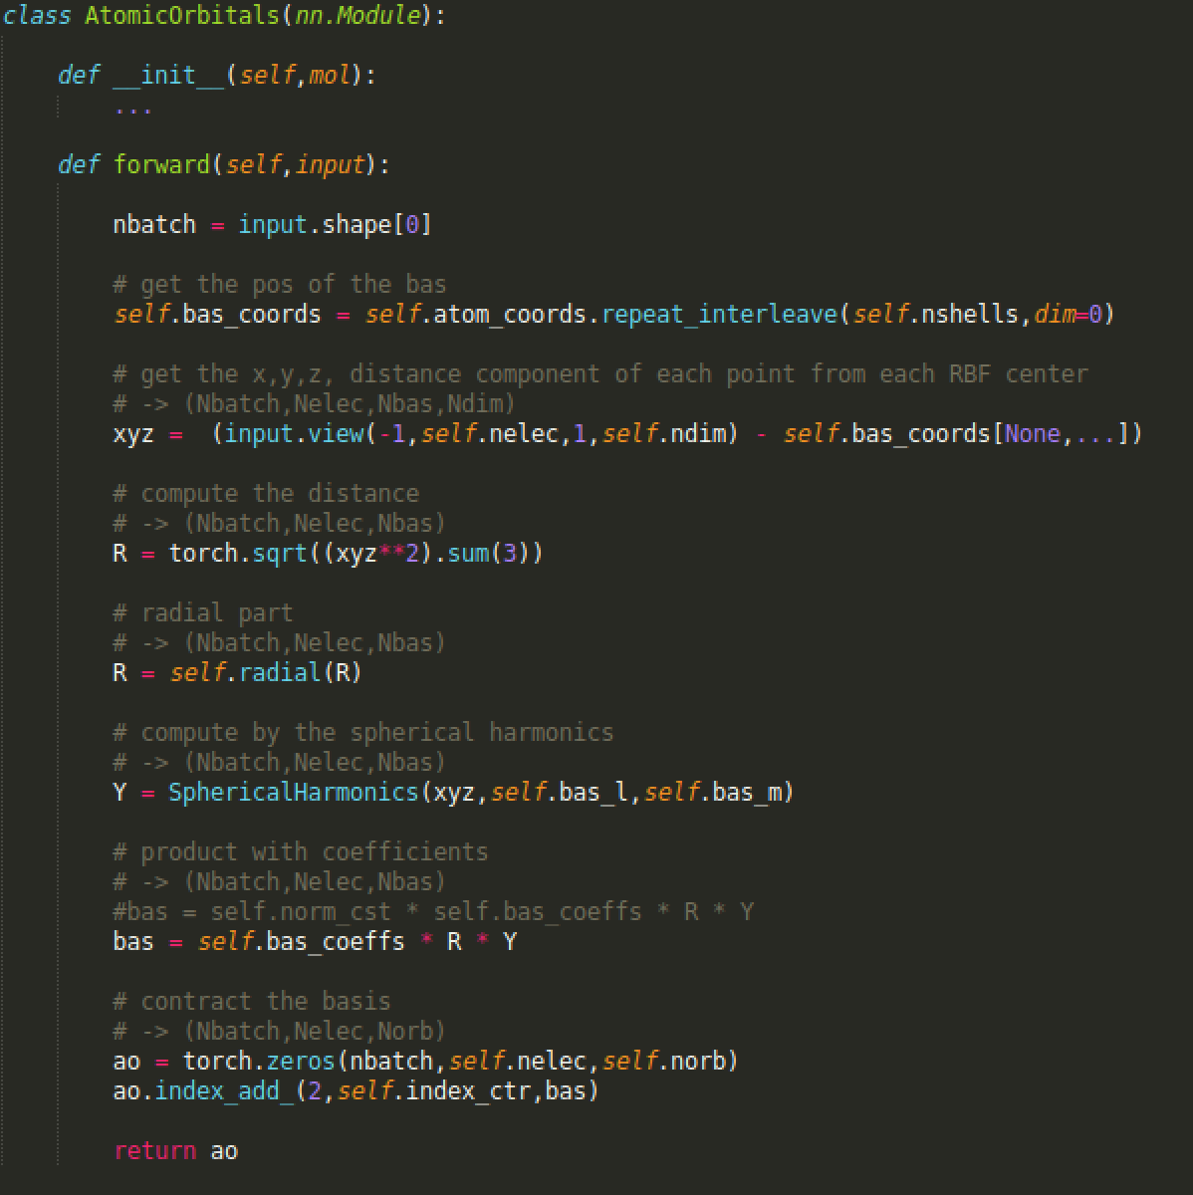
Atomic Orbital Layer in pytorch

Slide 25
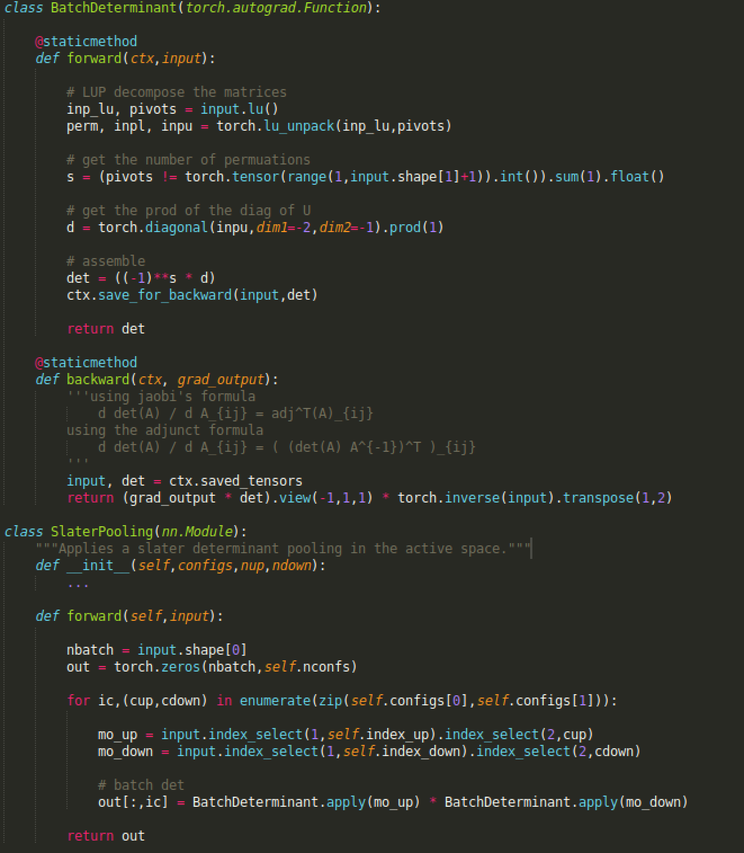

Slater Pooling

Slide 26
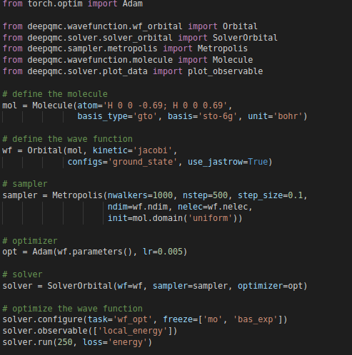
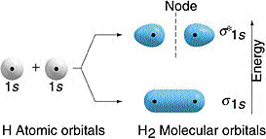
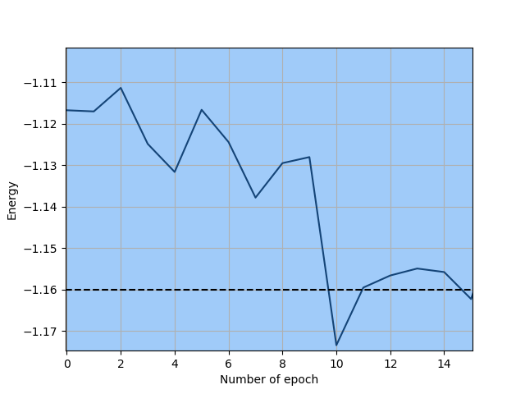
Optimizing H2 using DeepQMC

Slide 27
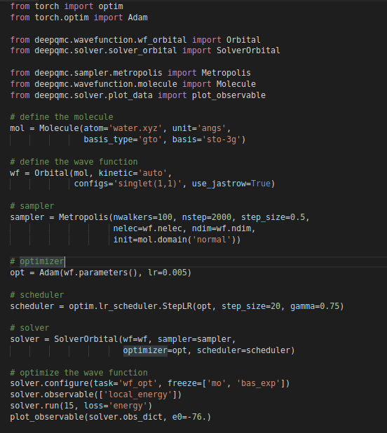
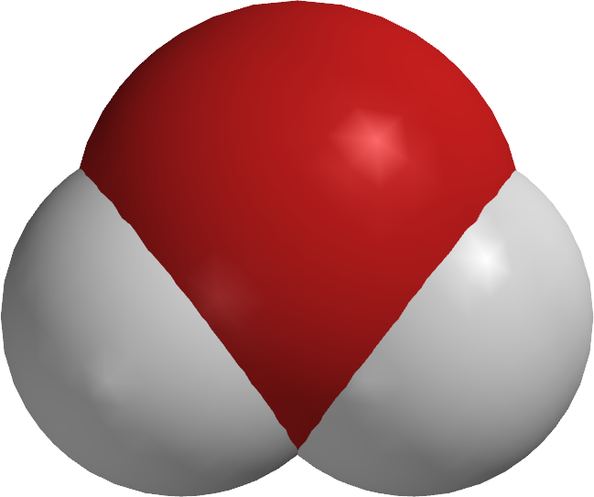
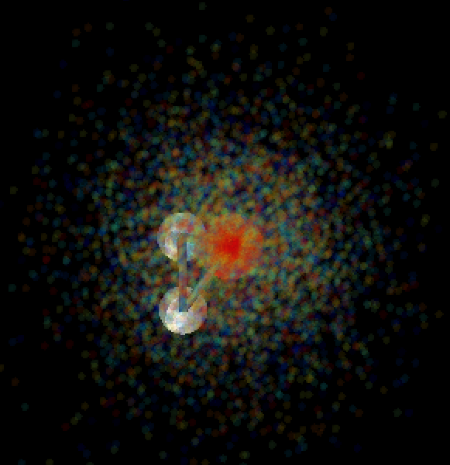
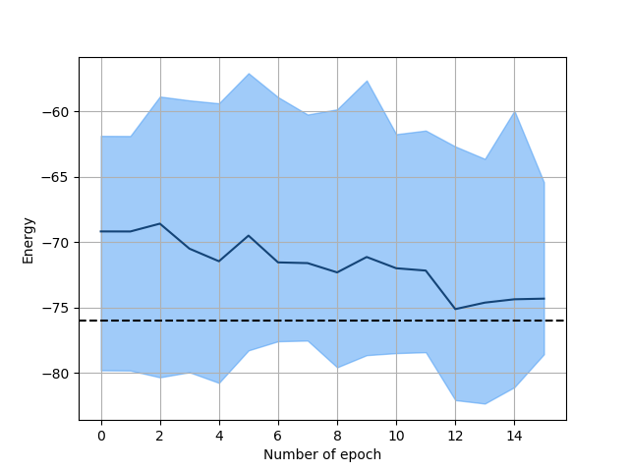
Optimizing a the wave function of H2O

Slide 28
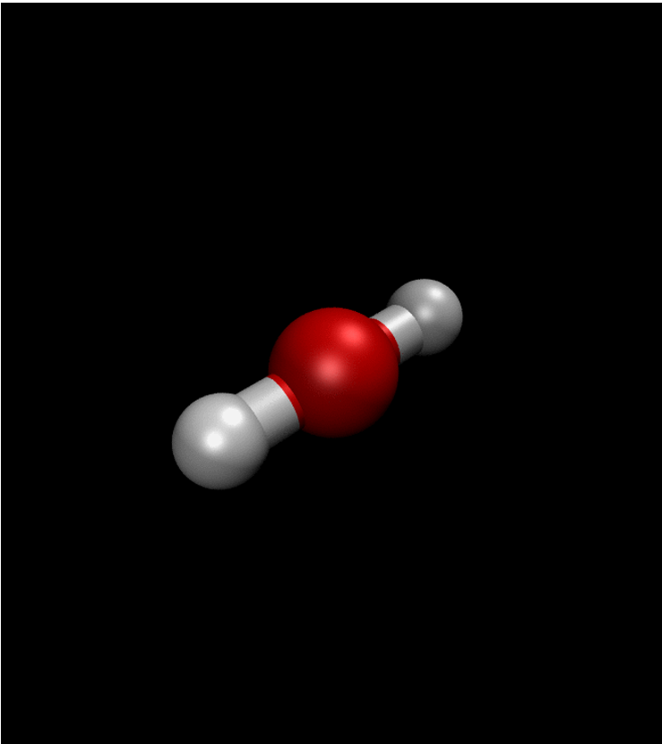
Optimizing the geometry of molecular structures
Atomic positions are
Parameters of the
AtomicOrbital Layer

Slide 29

Optimizing the geometry of molecular structures
Atomic positions are
Parameters of the
AtomicOrbital Layer
https://github.com/NLESC-JCER/DeepQMC

Slide 30



Illustration of RBF-NN QMC for a water molecule
https://github.com/NLESC-JCER/DeepQMC

Slide 31

Summary
Improve stability
Improve sampling & Increase number of walkers
Speed Up kinetic energy with Jacobi Formula
Port to GPUs
To Do List

